Slide 1
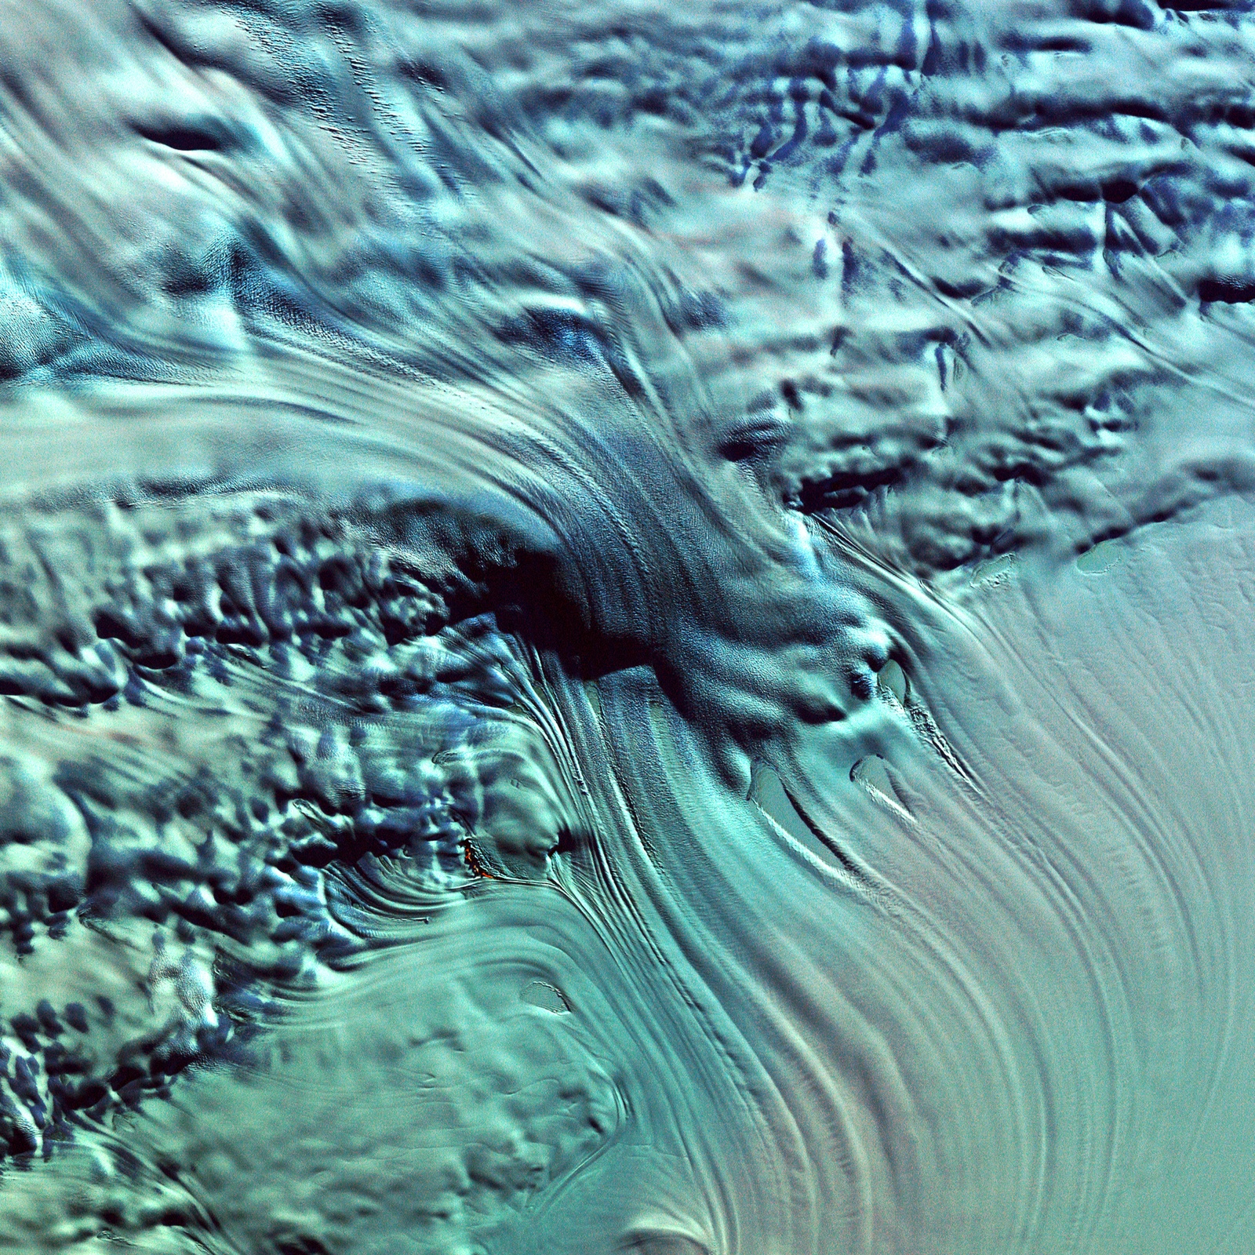
Generative AI and Image Processing
This slide provides a high-level overview of generative AI, a subset of AI focused on generating new content, and the key techniques and applications of image processing.

Slide 2



Introduction to Generative AI and Image Processing
What is Generative AI?
What is Image Processing?
Applications of Generative AI and Image Processing
A subset of AI focused on generating new content such as images, text, and audio.
Techniques to enhance, analyze, and manipulate images.
Art generation, data augmentation, image super-resolution, and more.
Generative AI and image processing techniques offer a wide range of applications, from creative art generation to enhancing existing images and data.

Slide 3


Key Libraries for Generative AI
Library
Description
TensorFlow/Keras
Frameworks for building and training deep learning models. Includes pre-trained models and tools for image generation and recognition.
PyTorch
Popular for research and production. Dynamic computation graph and extensive support for generative models.
TensorFlow Hub
Repository of pre-trained models. Simplifies transfer learning and model reuse.
TorchVision
Part of PyTorch. Tools and datasets for image processing.
*Provided context

Slide 4



Training Generative Models from Scratch
Data Collection
Model Selection
Training
Hardware
Evaluation
Gather a large dataset of high-quality images, such as the CIFAR-10 or ImageNet datasets. These datasets contain thousands of labeled images across various categories, which are crucial for training generative models effectively.
Choose a suitable generative model architecture, such as Generative Adversarial Networks (GANs) or Variational Autoencoders (VAEs). These models have different strengths and are suitable for different types of image generation tasks.
Use powerful deep learning frameworks like TensorFlow or PyTorch to build and train your generative model. Leverage the extensive libraries and tools provided by these frameworks to simplify the training process.
Train your model on powerful hardware, such as GPUs or TPUs, to accelerate the training process and enable the generation of high-quality, high-resolution images.
Assess the performance of your trained model using metrics like the Frechet Inception Distance (FID), which measures the similarity between the generated images and the real images in the dataset. This helps you evaluate the quality and realism of the generated images.

Slide 5
Practical Applications of Generative AI
Art and Content Creation
Data Augmentation
Tools like DeepArt and DALL·E can generate unique, artistic images by learning from vast datasets of art and visual styles. These models can create original images, illustrations, and digital art.
Generative AI models can enhance training datasets by generating new, realistic images. This data augmentation can improve the performance of image recognition and classification models, especially when dealing with limited training data.
Image Super-Resolution
Style Transfer
Models like SRGAN (Super-Resolution Generative Adversarial Networks) can take low-resolution images and generate high-quality, high-resolution versions by learning the mapping between low and high-res images.
Neural Style Transfer algorithms can transfer the artistic style of one image to the content of another image. This allows for the creation of unique, stylized images by combining the visual elements of different sources.

Slide 6



Future Trends and Challenges
High-Resolution Image Generation
Improved Training Algorithms
Ethical Concerns around Deepfakes
Ensuring Model Robustness

